Slide 1

IRBI Presentation
March 2020

Slide 2
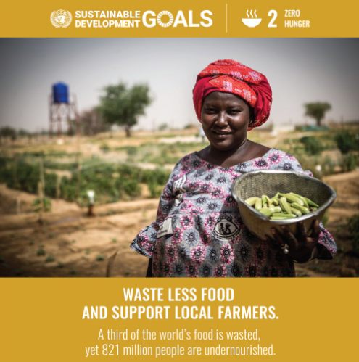
What is Sprout?
Focus on social change
Empowering local farmers
Providing fresh, organic produce to customers
Offering farm life experience

Slide 3
Vision and Mission
Vision:
Change how we grow, share and consume our food
Mission:
Create a mutually beneficial relationship between local farmers, customers, and the environment through fair exchange and shared farm experience.
Notes:
https://www.un.org/sustainabledevelopment/hunger/ In-line with UN sustainable goal

Slide 4
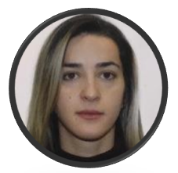


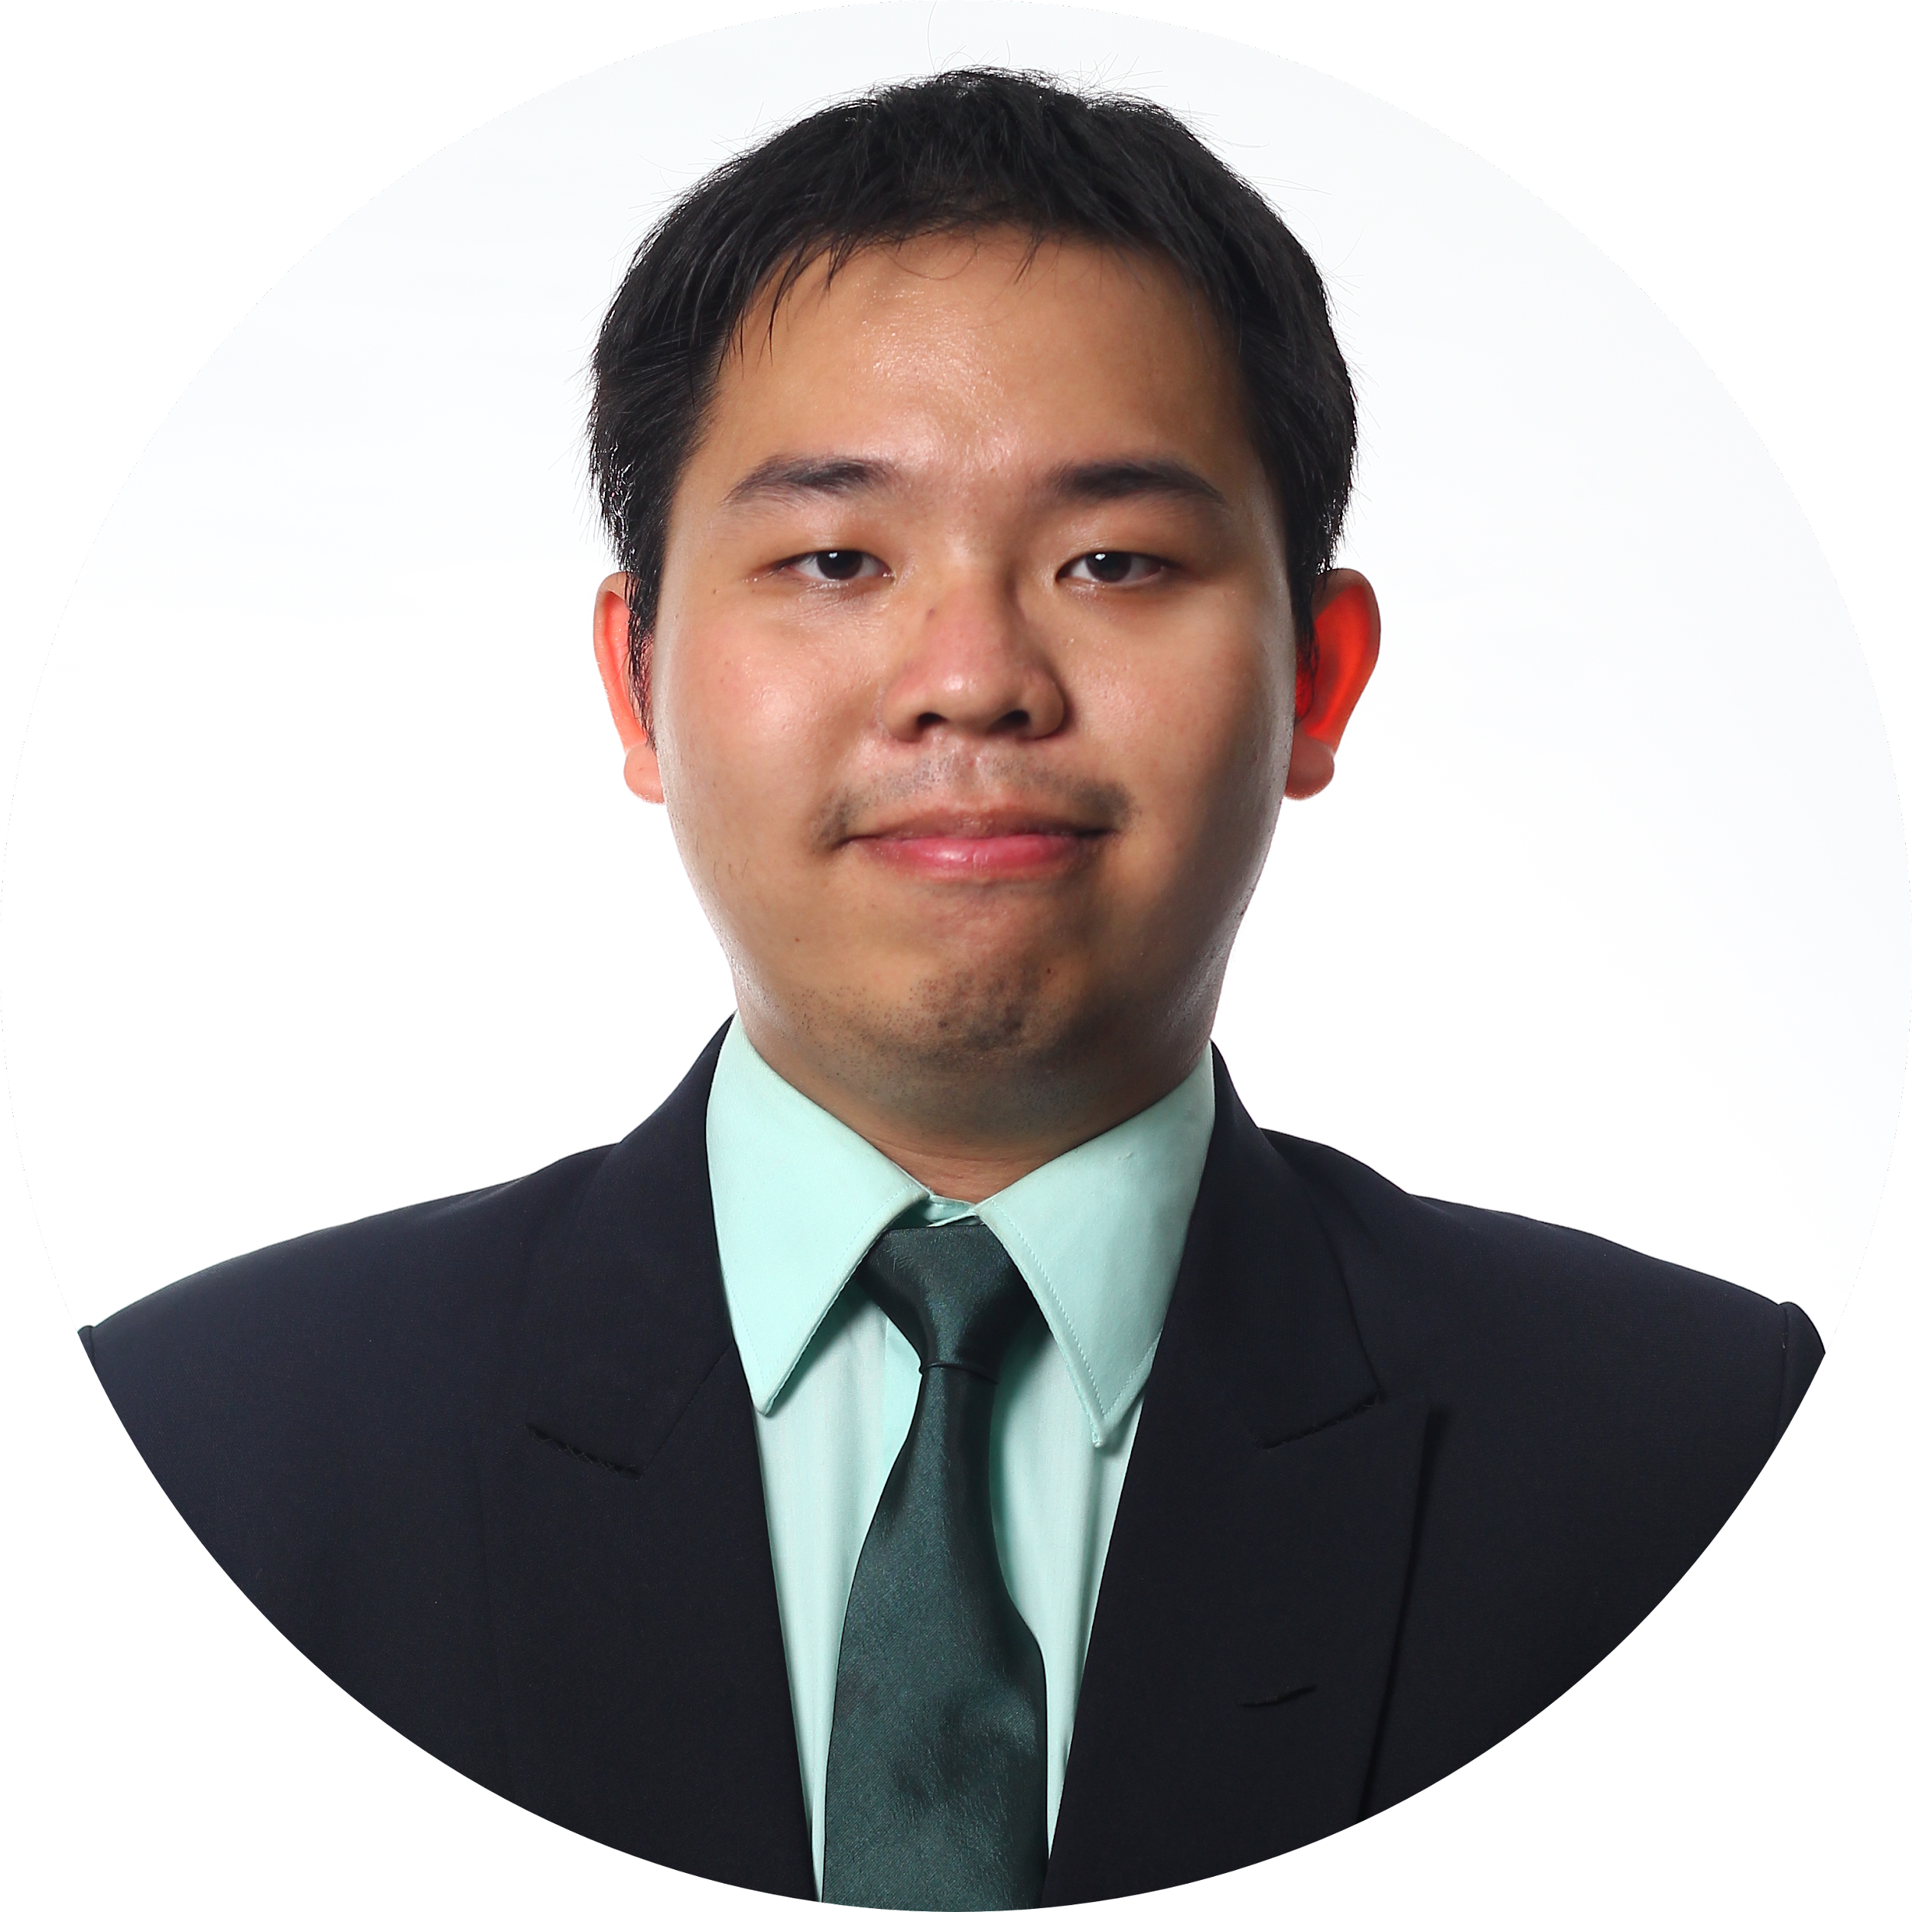
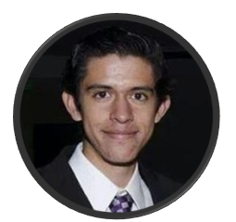
Meet the Team
Ariston Lim
Indonesia
Business Analyst
BDMA Masters Student
Nejada Karriqi
Albania
Software Engineer
Data Science Master Student
Julio Candela
Peru
Data Scientist
BDMA Masters Student
Valdemar Hernández Siles
Mexico
Digital Systems Engineer
BDMA Masters Student
Hung Nguyen
Vietnam
Data Scientist
BDMA Masters Student

Slide 5
Business Models
Grocery Ordering
Subscription Model
Experience: Open Day at the Farm
Notes:
open day -> good option for older people / families

Slide 6
Client-product Binomy (Client)
There is a demand for organic food
2020 will be the decade when organic will become a mass phenomenon (BIOECO)
In European Union:
Organic agricultural land surface grew by 75% (2008 - 2017)
The number of organic producers grew by 4% during 2017
The retail sales value in EU was 34.3 billion € in 2017 (1,962 million € in Spain)
Notes:
https://blog.elogia.net/rfm-recency-frecuency-y-money-qu%C3%A9-valor-tiene-nuestro-cliente

Slide 7
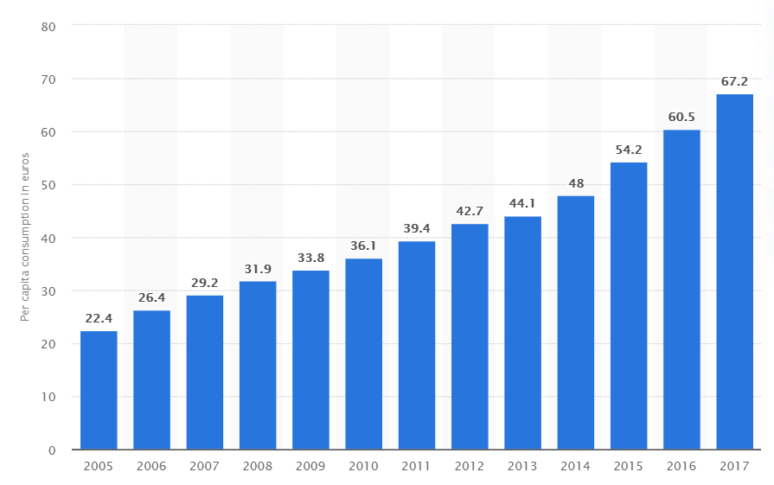
Per capita consumption of organic food in the EU
Notes:
https://blog.elogia.net/rfm-recency-frecuency-y-money-qu%C3%A9-valor-tiene-nuestro-cliente

Slide 8
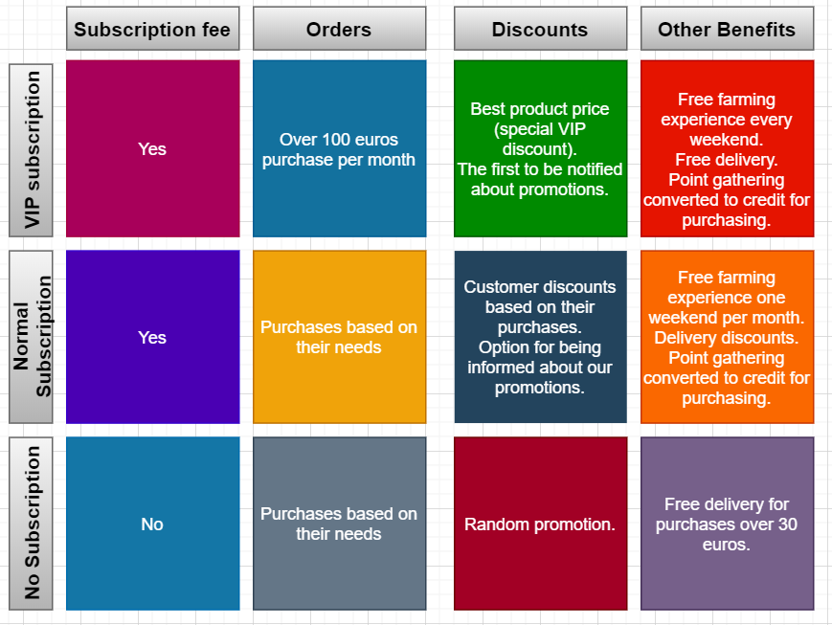
Client-product Binomy (Product)
Notes:
https://blog.elogia.net/rfm-recency-frecuency-y-money-qu%C3%A9-valor-tiene-nuestro-cliente

Slide 9
Why is it innovative?
An integrated platform to connect organic farms and customers
Subscription System - People can subscribe to get produce weekly or fortnightly
Open-day - Customers can have interesting experience in the farms at the weekend
Smart recommendation system for suggesting price and discount, taking into account demand and seasonality
Notes:
Farmers can also offer dining experience (“catering”) during the open farm day

Slide 10
Porter Analysis
Complex supplier management and logistics for new entrances
High Threat
Moderate Threat
Threat of Entrance
Low Threat
Lots of farms in Spain: many suppliers
Cheap prices for massive purchases of supermarkets
Power of Suppliers
Power of Clients
Competitive Rivalry
Few direct competitors
Threat of Substitutes
Lots of customers looking for cheap, fast and quality products
Supermarkets:
Cheap prices and close to homes.
Medium quality
Notes:
Conclusion: Gaining and engaging customers with our idea instead of using supermarkets, we can fastly and strongly set and control our business for a long time.
Competitor: Agroboca. https://www.agroboca.com/en/project-agroboca

Slide 11
S.W.O.T. Analysis
Strengths | Weaknesses
Attractive for farmers Provide an experience Eco-friendly Subscription model | Lack of capital More expensive Logistics
Opportunities | Threats
Few direct competitors Healthy trend | EU Competition Perishable food

Slide 12
Conclusion
Few direct competitors
Abundance of farms -> easy to connect
Increasing interest in organic food
Notes:
About transport? At the beginning, we could use our own resources to start with this.Buy/rent ground transportation and hire a driver to make the deliveries. As the company progresses, we can start exploring more delivery methods (increase our fleet or use external services as UPS, etc)

Slide 13
Thank You

